Slide 1

FARMCONNECT

Slide 2




TEAM NAME:BELIVERS.
TEAM -13
1. ABHIRAJ SALUNKE (TEAM LEADER)
2.SANSKAR PADWAL
3.TANISH JAIN
4.UDIT KHADKE
5.ADITYA HARDE.
6.VISHAL JADHAV
PROJECT NAME:
FARMCONNECT

Slide 3

PROBLEM
Farmers are not getting to know about new technologies and unaware about new technologies. They are still using old products for their farming.

Slide 4
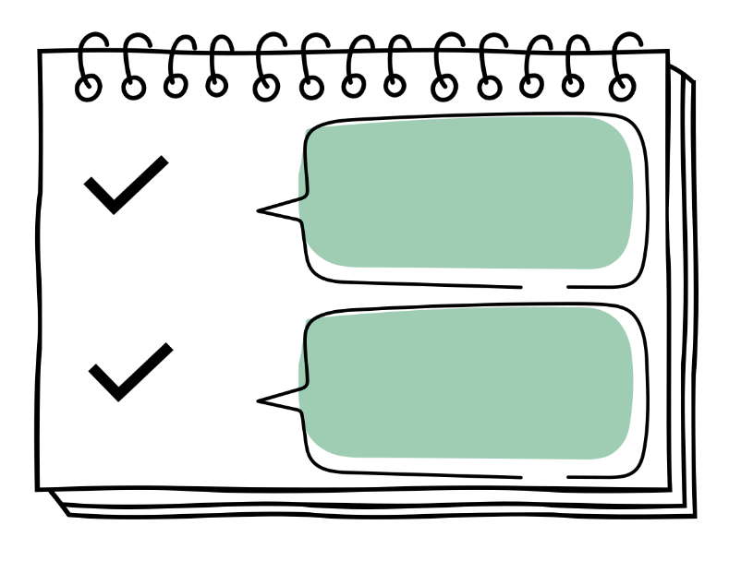
PROJECT OBJECTIVES AND GOALS:
TO DEVELOP A APPLICATION FOR ONLY FARMERS WHERE FAMERS ARE GET TO KNOW ABOUT VARIOUS NEW TECHNOLOGIS ABOUT FARMING, WHERE EVEY DEVELOPR CAN UPLOAD THEIR NEW PRODUCT AND USERS WHICH ARE FARMERS CAN EASILY KNOW ABOUT IT AND CAN USE. HERE THEY ALSO CAN KNOW INFORMATION ABOUT PRODUCTS AND HOW TO USE MANUAL (A SPECIFIC VIDEO OF PRODUCT)BY DEVELOPER. THESE WILL BE DIRECT CONCACT BETWEEN USER AND DEVELOPER/SELLER.
FARMERS CAN ALSO CONNECT TO DIFFERENT STATES FARMERS AND CAN CONTACT THEM. HERE FARMERS CAN ALSO SUGGEST THEIR NEW INNOVATIVE IDEAS ABOUT FIELD AND WHOEVER THE DEVELOPER IS CAN IMPLEMENT ON IT. THESE WILL HELP FARMERS AND MAKE THEIR WORK LOAD EASY.

Slide 5

EMPATHY MAP & PERSONA
Our app is for farmers and farmers are also suffering form problem because they are not getting to use new technology . They need the technology to make their workload less . Their thought about app, farmers are happy as app is easy to use and they ae getting to sell their ideas through our app.
The app is only for farmers and product owner and seller, this app include all languages and can use all age farmers who are using this application. Goals for our app is to only help farmers to earn and express their new innovative ideas to the world.

Slide 6
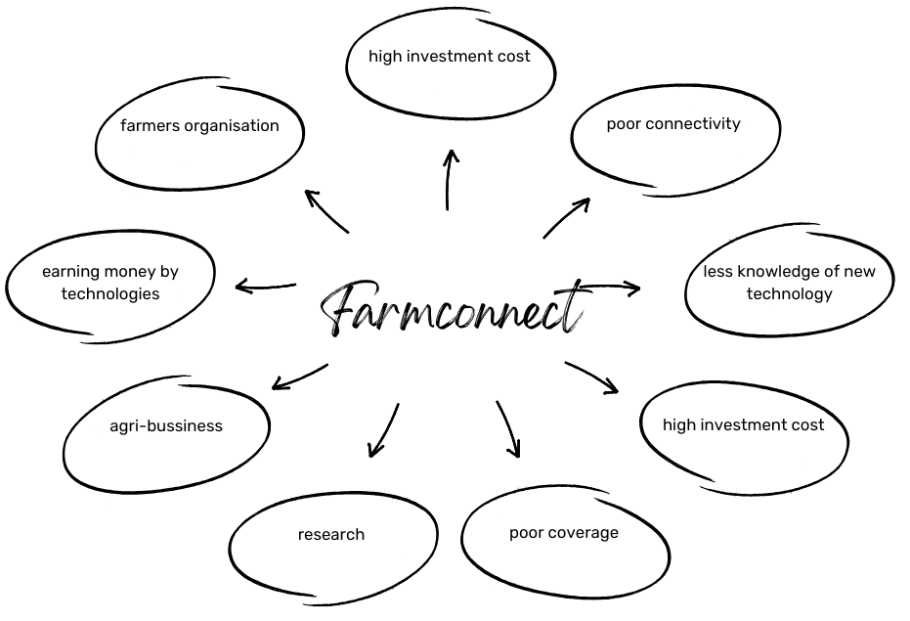

BRAINSTROMING ACTIVITY

Slide 7
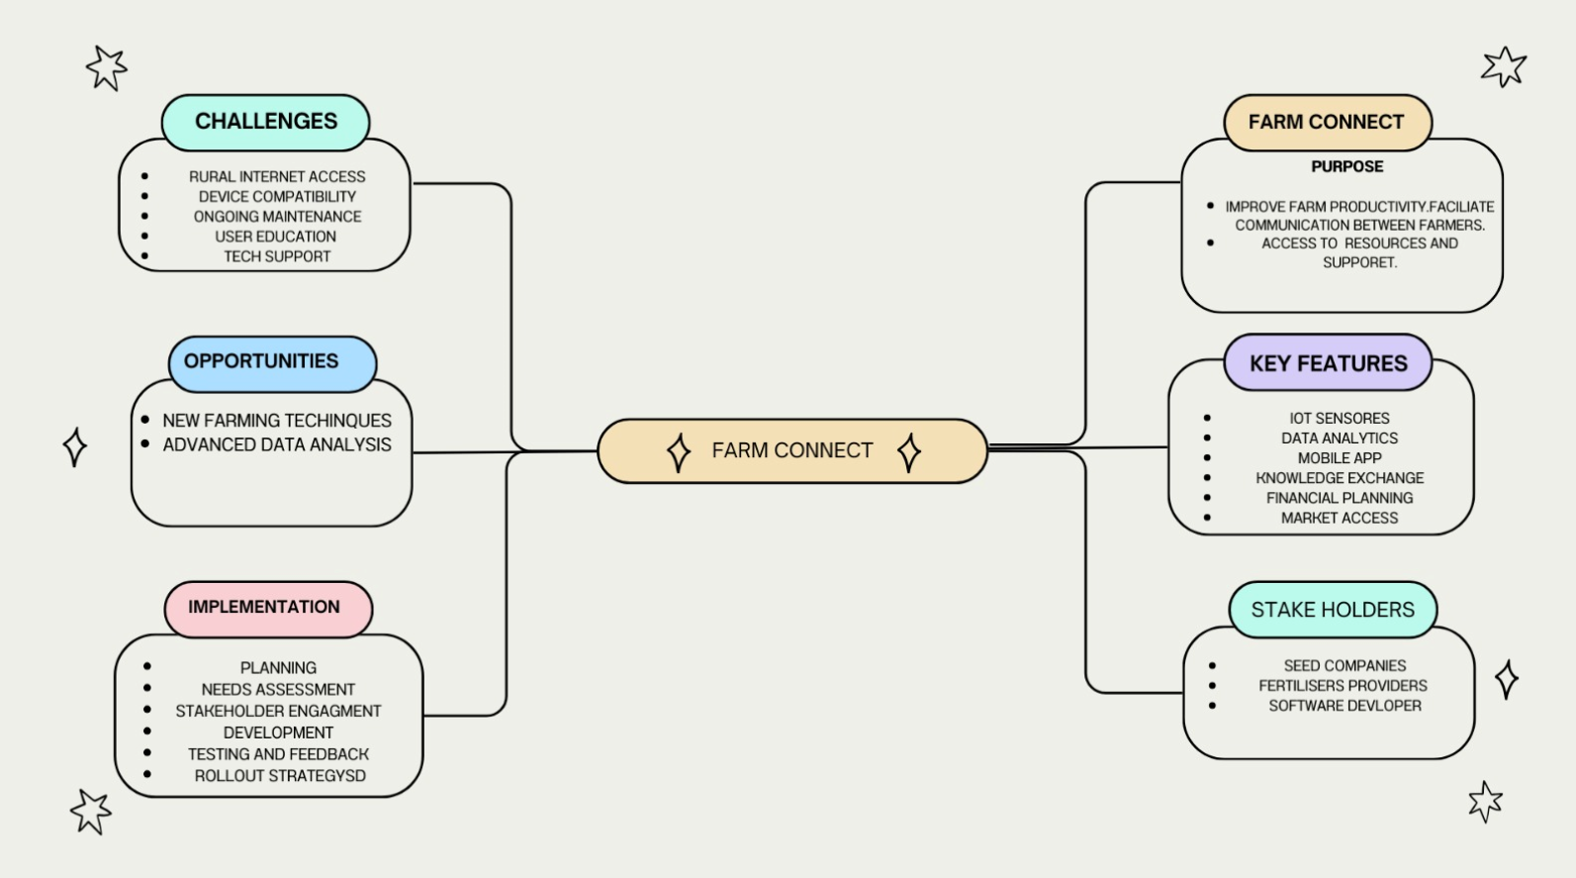

mind mapping
.

Slide 8

THEORY OF PRIORITAZATION
10gm | 100gm | 1000gm
log-in through google account or I-phone. Wishlist the items farmers want to buy afterwards. | Language can change as per need of farmers. Buy or sell product. Other state farmers can connect to each other through our application. Farmers can message to each other in the application. | New Product can sell in the application by farmers. Buy or sell product by the owner and farmers. Farmers can also earn money through it by add their new innovative ideas in the application.

Slide 9

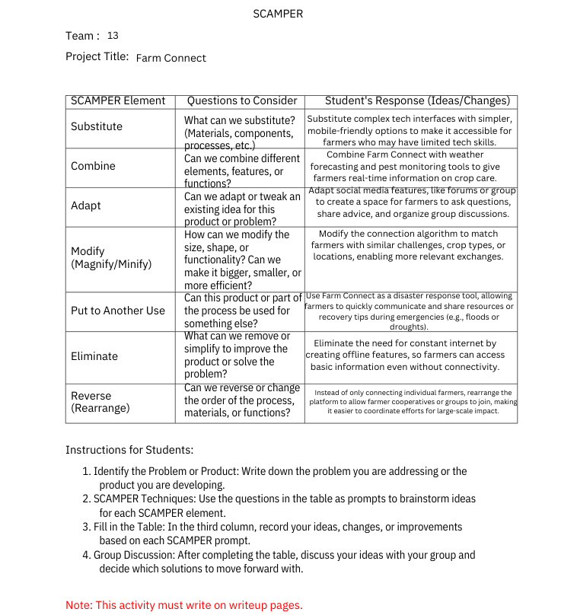
SCAMPER TOOL APPLICATION

Slide 10


Technology stack & prototype overview
TECHNOLOGY WE USED:
SOFTWARE: 1. flutter- It can be used to develop cross platform applications from a single codebase
2. POS -Retail POS software is software that records sales transactions at the point of sale
3.ecommerce- It is used to create and manage online stores, websites, and mobile apps that sell products or services to customers.
4.GPS insight: GPSD Tracking is an exemplary model of how long away our product is and where other farmers are connected from different states. Swift Weather
5. Swift Weather: used to determine weather around your area.
6. programming language: “python” for analyze data of user (farmer).

Slide 11

KEY OUTCOME & LEARNINGS:
Enhanced Resource Sharing
Farmers can easily share resources, equipment, and services, reducing costs and improving efficiency . Improved Knowledge Exchange
Farmers can exchange expertise, discuss crop management techniques, and learn best practices from each other, leading to better crop yields and farming methods . Increased Access to Market Information
Farmers can share real-time information on crop prices and demand, helping them make more informed selling decisions and maximizing their profits . Strengthened Farmer Network and Support System
Establish a support community where farmers can rely on each other for advice, encouragement, and assistance during challenges or crises . Streamlined Bulk Purchasing and Collective Bargaining
The platform can enable collective purchasing, giving farmers the power to buy inputs in bulk at discounted rates, reducing costs on essentials like seeds and fertilizers.

Slide 12

Future steps:
1. Scale User Base and Regional Expansion Objective: Expand Farm Connect to reach more farmers across different regions or countries action: Identify priority regions based on demand and farming challenges; partner with local agricultural bodies for targeted outreach; translate and localize the platform for regional languages and farming practices.
2. Enhance Platform Features Objective: Build on the existing platform with more sophisticated tools to support farmer needs actions : Introduce new modules for advanced weather forecasting, soil analysis tools, crop disease identification, and personalized recommendations based on location and crop type.
3. Develop Data Analytics and Reporting Objective: Provide actionable insights to farmers based on usage data and trends actions : Use data analytics to generate reports on market trends, crop performance, and best practices. Offer personalized suggestions for farmers based on their activity and location
.4. Strengthen Partnerships and Collaborations Objective: Create a network of stakeholders, including agricultural suppliers, local cooperatives, and government bodies, to provide additional resources and benefits to farmers Actions: Partner with suppliers for discounted inputs, collaborate with agricultural experts for knowledge content, and engage with government bodies to gain support or subsidies for farmers.

Slide 13
THANKYOU…..

